Slide 1
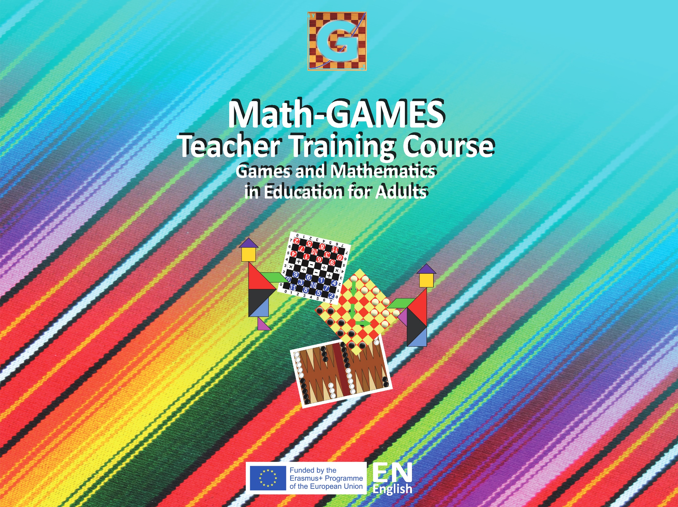

Slide 2
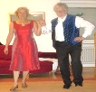
5.2 Seven Steps (German Dance)
Objectives
Participants should be taught to count reliably up to 8 items. The dance Seven Steps was chosen as a moving game. Seven is the biggest number of danced steps and eight the biggest number of music bars (music clock).
They should understand the difference of the dance rhythm with seven performed steps and count the eight times (quaver time).
The dance “Seven steps” combines counting and movement. It was chosen, because of its “loosen up” and its emotional quality.
Participants should identify two-dimensional shapes of steps on the floor or painted on a paper.
They should learn to count up to 7 by dancing in the first phase, up to 3 in the second phase, up to 4 in the third phase.

Slide 3
5.2 Seven Steps (German Dance)
Tools, Materials and Organisation
Free space for dancing
Danced by two persons in a row or in a circle
Prepare copies from the worksheets
The lesson has two parts and takes 90 minutes

Slide 4
5.2 Seven Steps (German Dance)
Description of the Lesson
First part of the lesson
Experiencing the melody and the steps:
  Sing the song several times in the group with the text, which is at the meantime explaining the steps.
  Alternative: an instrument plays the melody, e.g. guitar or flute; or download the song from the Internet.
Rhythmic walking with short steps and long steps:
  Phase a: seven steps; Phase b: four steps.
  Counting up to 7, 3, 4 in the different phases of the dance.
Arrange the dancing group with couples in a row or in a circle.
Performing altogether the three phases of the dance in an easy going way – just to have fun by moving, counting and singing. Making mistakes is just a part of having fun.

Slide 5
5.2 Seven Steps (German Dance)
Analysing the dance in two groups: One part of the learners is dancing, the other part is watching.
Discussing and experiencing the steps in the whole group (e.g. 7th step as equivalent for tact 7+8).
Perform the dance several times in the group. Task for the watching group: Describe the dance with your own words (partner work).
Worksheet #1. Form to be filled in by the participants (single or partner work).

Slide 6
5.2 Seven Steps (German Dance)
Description of the Lesson
Second part of the lesson
Explication of different ways of showing quantities
  (in a line - horizontal or vertical, in a circle, a cross etc.)
Different ways of designing a melody
  (form with five lines, by forming a wave with the hands moving up and down, designing a graph line with two variables: height and time)
Worksheet #2 is handed out to each participant
Participants make lines around different quantities. Participants fill in the empty graph line
Discussing open questions and performing the dance at the end of the lesson

Slide 7
5.2 Seven Steps (German Dance)
Useful Hints
The dance can be an ice-breaking in other lessons.
The graph line is related to music and the writing of notes. So it may be combined with a music lesson.
It is difficult to combine different movements and rhythmic systems steps on the ground clapping of hands singing a melody or counting aloud → It may be regarded as a quite ambitious pedagogical approach.
More information in the Internet, e.g. TaKeTiNa https://en.wikipedia.org/wiki/TaKeTiNa_Rhythm_Process
Seven Steps Introduction: https://www.youtube.com/watch?v=PcPne-xD0x4
A Test of the Seven Steps Dance in Messini/Greece: https://www.youtube.com/watch?v=I16t9fup14Q

Slide 8
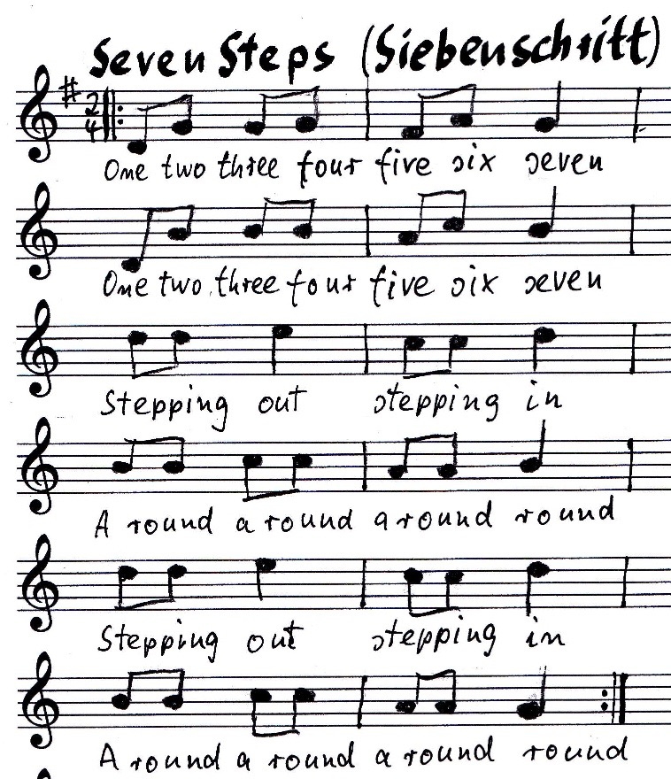
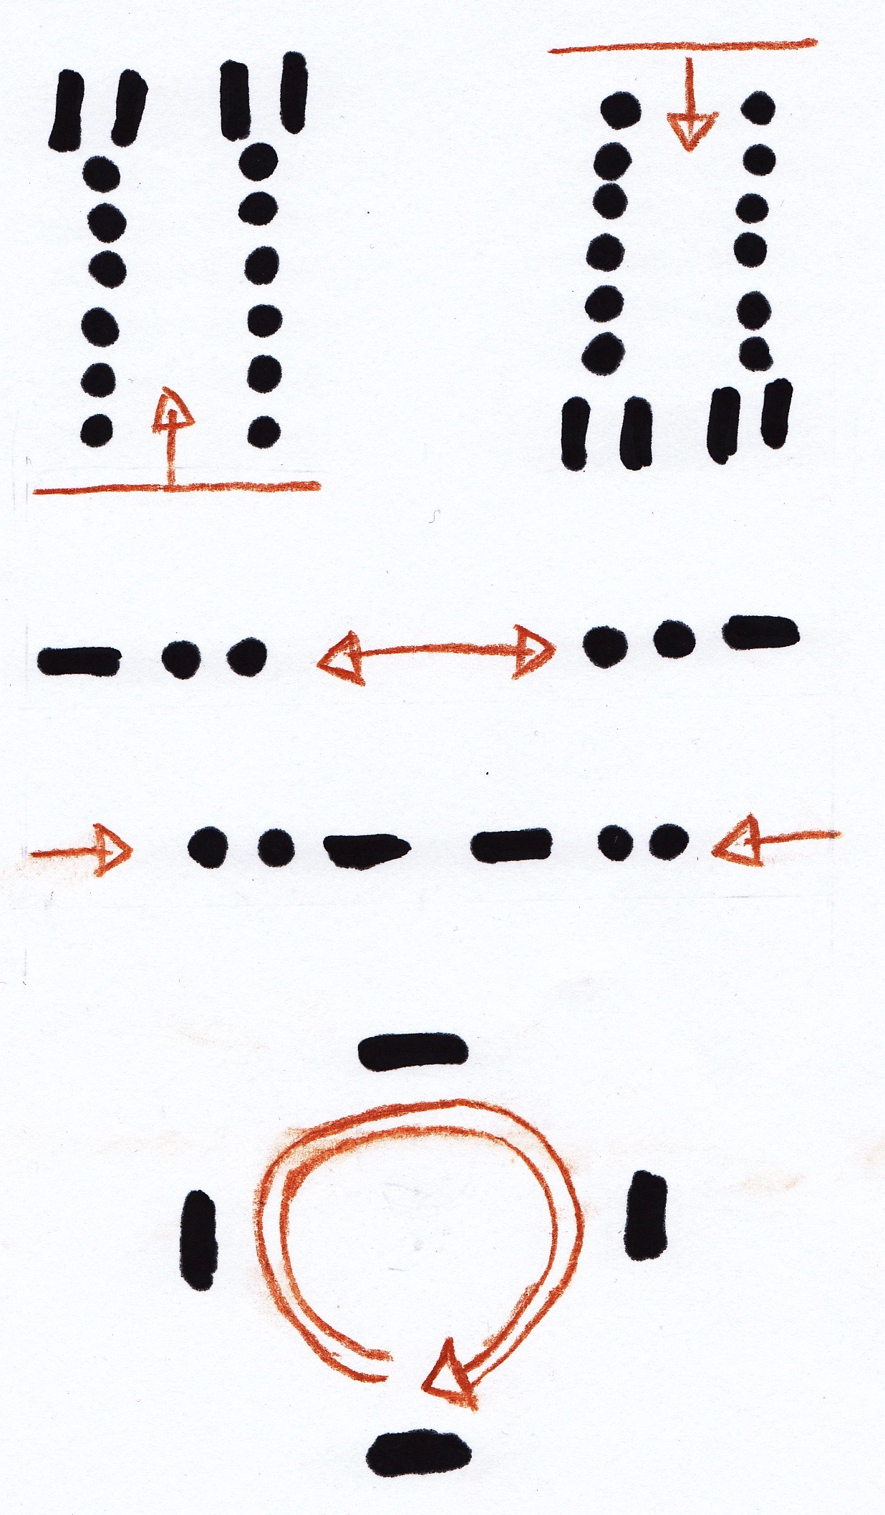
5.2 Seven Steps (German Dance)
Notes & steps
Which rows of the melody and which parts of the steps are related to the three phases of the dance?
Part (a) of the steps graphic — rows 1 and 2 of the notes
Part (b) of the steps graphic — rows 3 and 5 of the notes
Part (c) of the steps graphic — rows 4 and 6 of the notes

Slide 9
5.2 Seven Steps (German Dance)
Form to be filled in by the participants:
Phase | Number of steps: Short Long | Number of tacts: clapping hands | Remarks
A | 6 1 | 8 | Twice: Foreward and backward
B | 2 1 | 8 | Twice: Outside and inside
C | 0 4 | 8 | Each couple is dancing in a circle
Further explanation to the form: Phase (a): 7 steps, phase (b): 3 steps, phase (c): 4 steps

Slide 10
5.2 Seven Steps (German Dance)
Additional:
LONG — SHORT in other dances: Students may describe the rhythm of other dances of their choice e.g. Sirtos or Kalamatianos.
Short — short — long: This type of rhythm is called in poetry „Anapest“
Long — short — short: This type of rhythm is called in poetry „Dactylous“
Seven Steps in phase (b) with the rhythm “Short — short — long” is an Anapest and Sirtos or Kalamatianos with the rhythm “Long — short — short” is a Dactylous.
According to theories of poetry and music, the anapest-rhythm is energizing and the dactylous-rhythm is harmonizing.

Slide 11
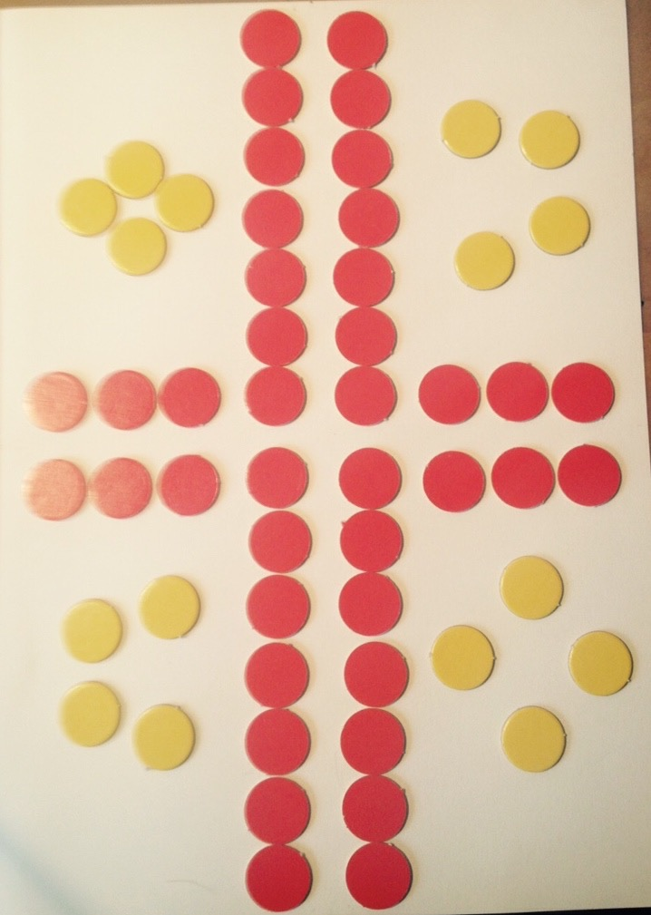
5.2 Seven Steps (German Dance)
For developing a sense of structure the students can identify and mark the numbers of dancing steps 7 - 3 - 4 by making lines for different quantities:
Seven pieces - arranged vertically (four times: 4x7=28)
Three pieces - arranged horizontally (four times: 4x3=12)
Four pieces - arranged in the four corners (four times: 4x4=16)
Altogether 56 pieces (28+12+16)

Slide 12
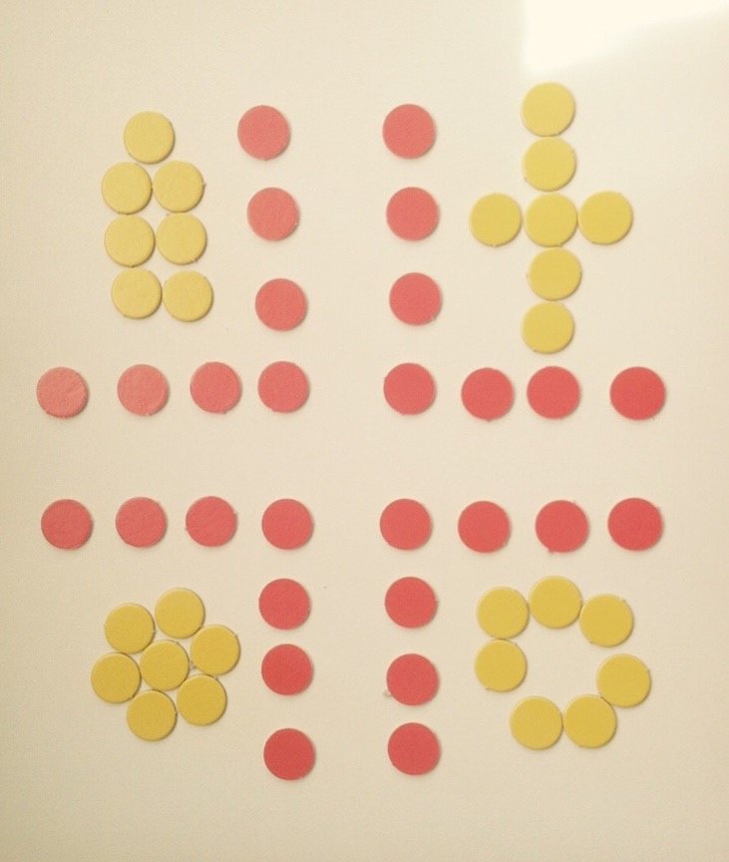
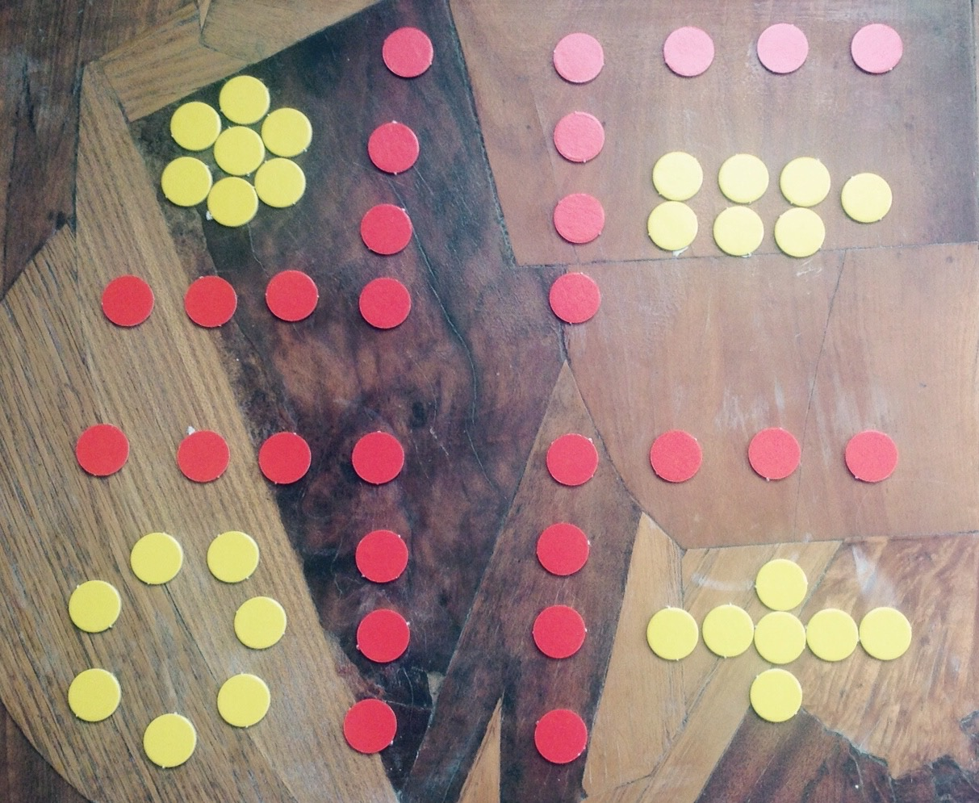
5.2 Seven Steps (German Dance)
Additional:
Playing with different quantities related to the dancing steps and with different background. Students may create their own arrangements.
Here two examples: different quantities and a polychrome background.

Slide 13
5.2 Seven Steps (German Dance)
How to show a melody?
Notes are a common form used in music.
There are other possibilities:
Hands moving up and down following the melody.
Combining the movement of the hands up and down and making the steps with the feet on the ground.
Constructing a line graph. (Time and height as variables of the diagram.)

Slide 14
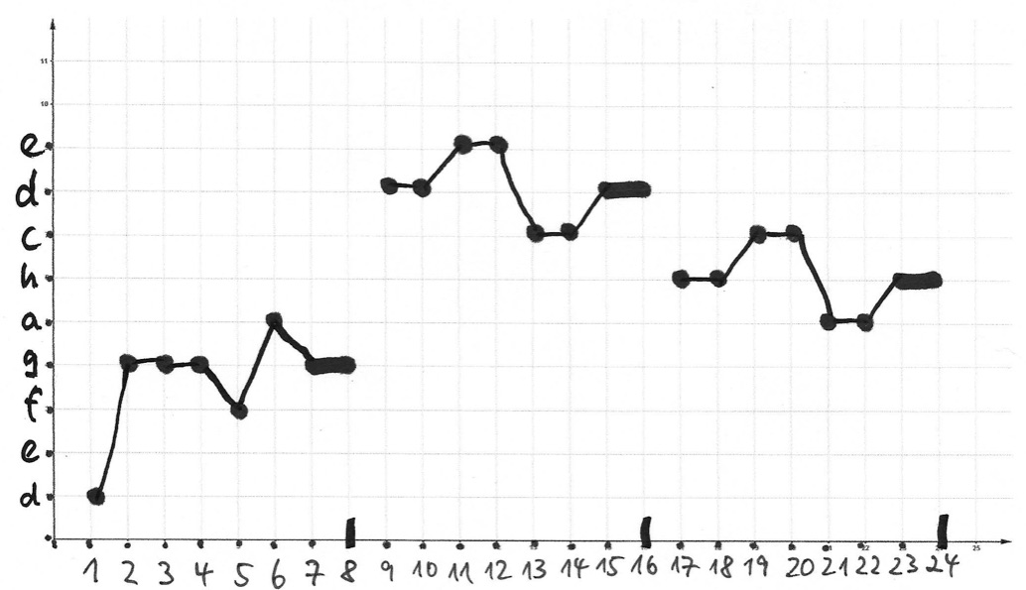
5.2 Seven Steps (German Dance)
Line graph, Variables: Height (tones/notes) & Time (tact unites)
Height
Time
Sheet with melody: 1st line 3rd line 4th line
Students may form the wave of the melody first with hands in the air. Then they are informed about the notes: lowest note of the melody (d) and highest note of the melody (e), and then fill in the empty form - in single or partner work.

